Slide 1
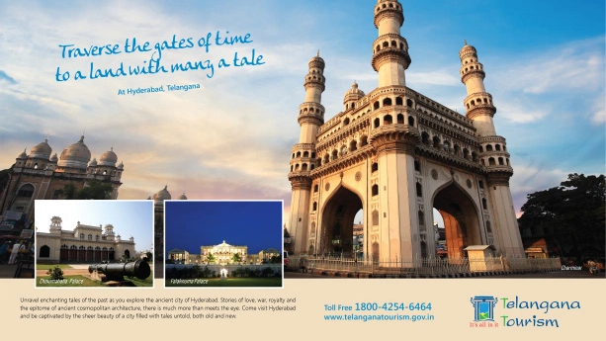
YATRA Site
AKHILA.PAIDY 1602-16-737-005
Maheshwari 1602-16-737-021
Akash 1602-16-737-002

Slide 2
contents
Abstract
Use Cases
Architecture And Technology Used
Results
Conclusion and future work

Slide 3
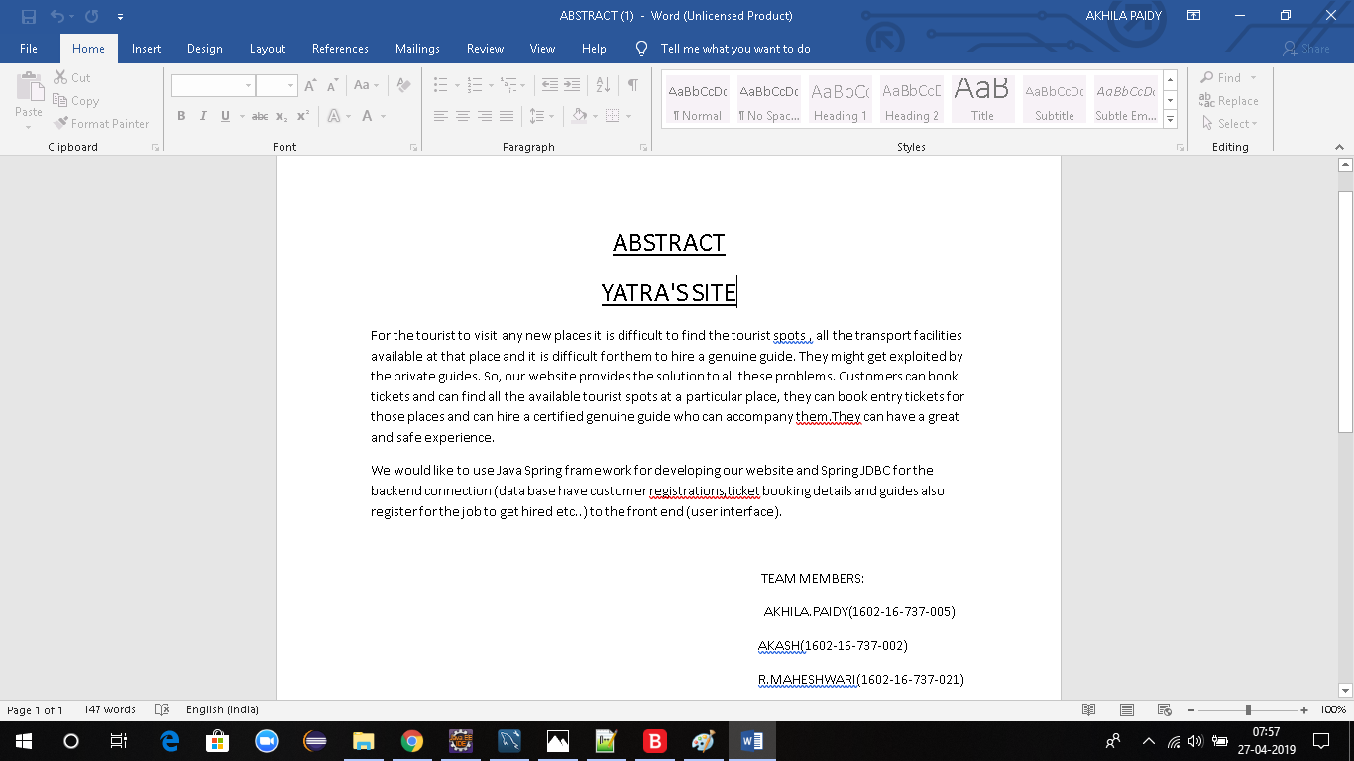

Slide 4
.
Use Cases:
1.Customer Trip selection and buying entry Ticket
2.Trip cancellation
3.Trip allotment to guide
4.Trip Status
5.Transportation details

Slide 5
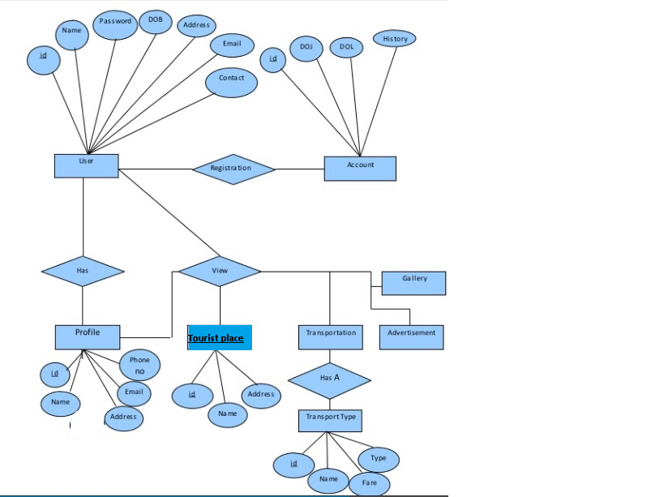
Architecture and Technology Used:

Slide 6
.
Technology Used:
Front end:
Bootstrap
Backend:
Spring Boot
Sql hibernate
Ajax Request calls for integration

Slide 7
.
In the integration we use ajax calls.
When we enter the data a ajax request call is called.
In the controller api rest calls are generated and required url is hit.
In service the business logic is given.
DAO is accessed and jason is called and the reuired result is displayed.

Slide 8
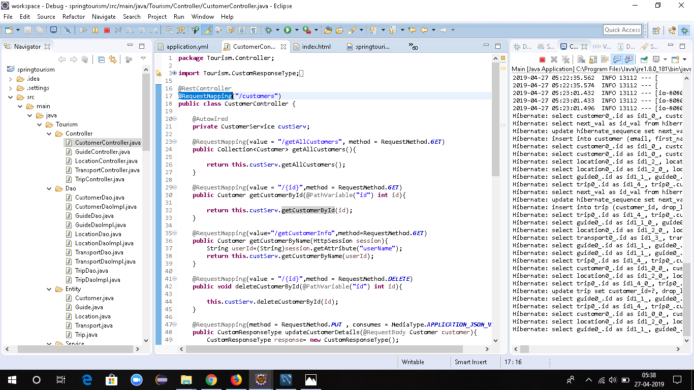
Ajax request call:

Slide 9
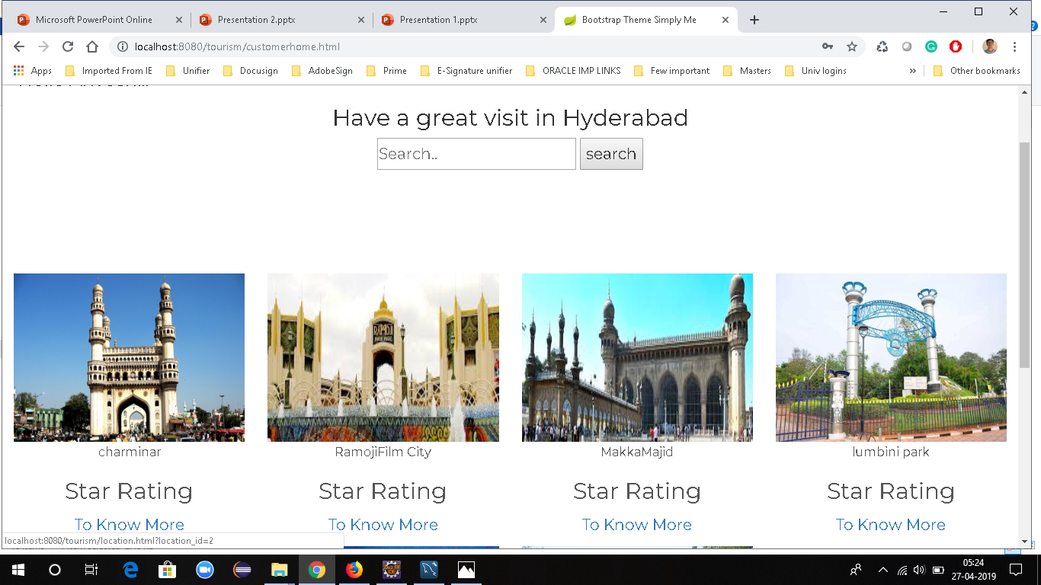
Results:
Customer trip selection and ticket buying:

Slide 10
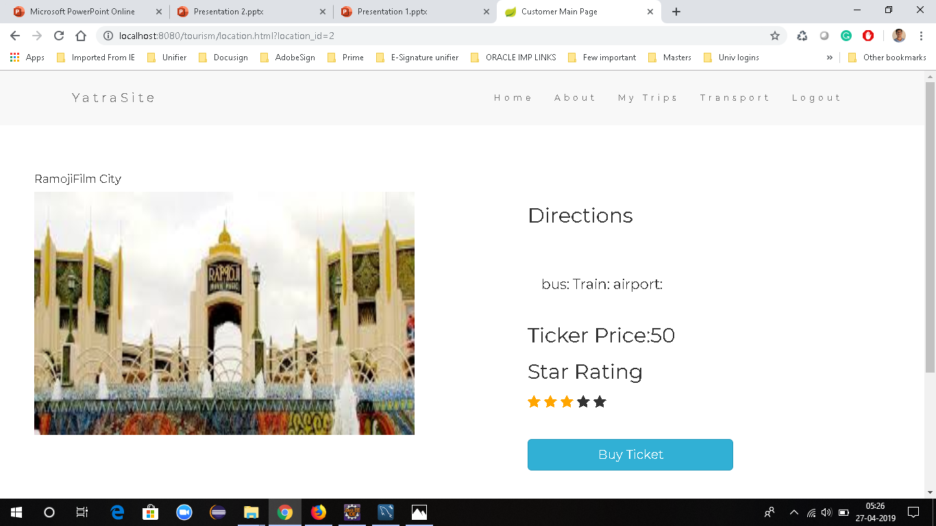

Slide 11
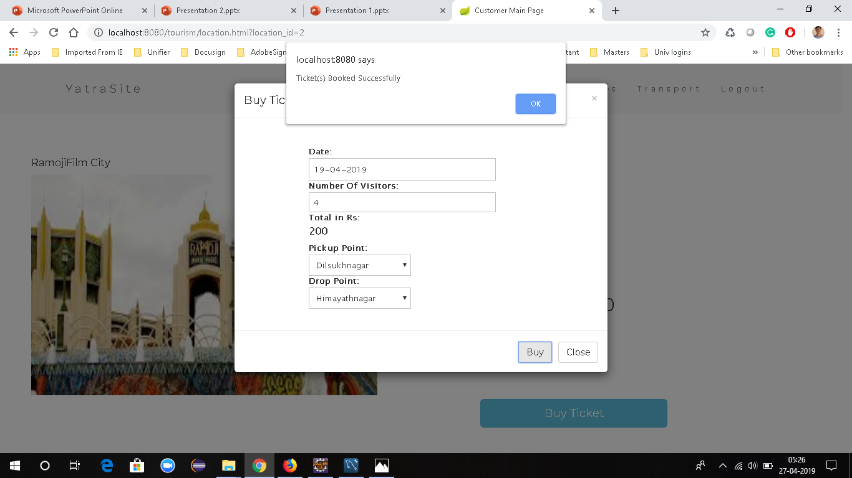

Slide 12
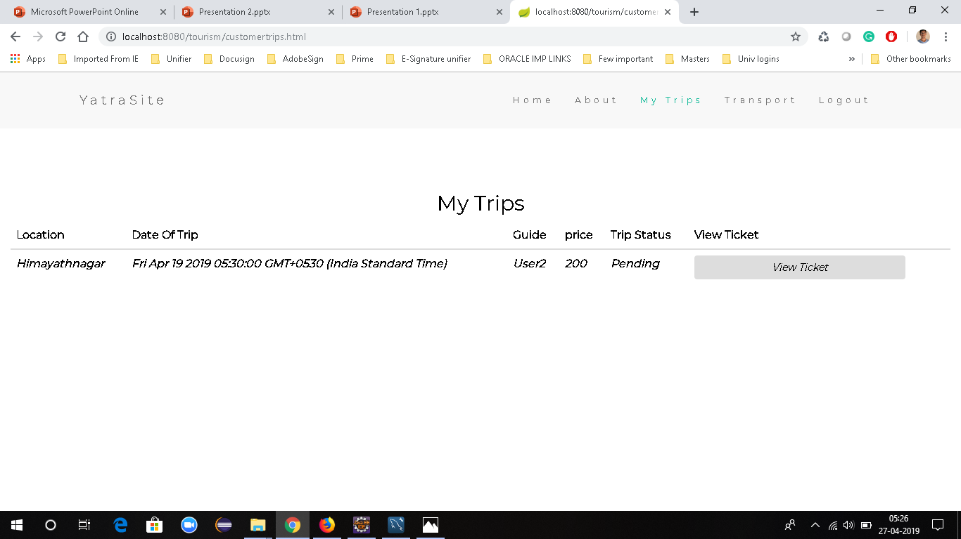
.
Trip Cancellation:

Slide 13
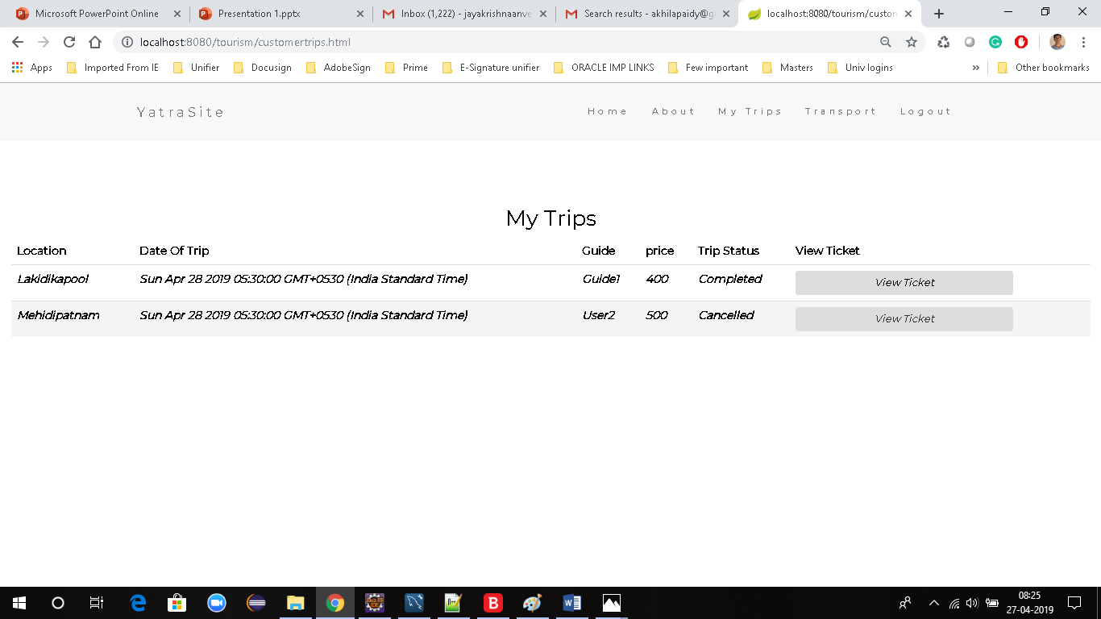

Slide 14
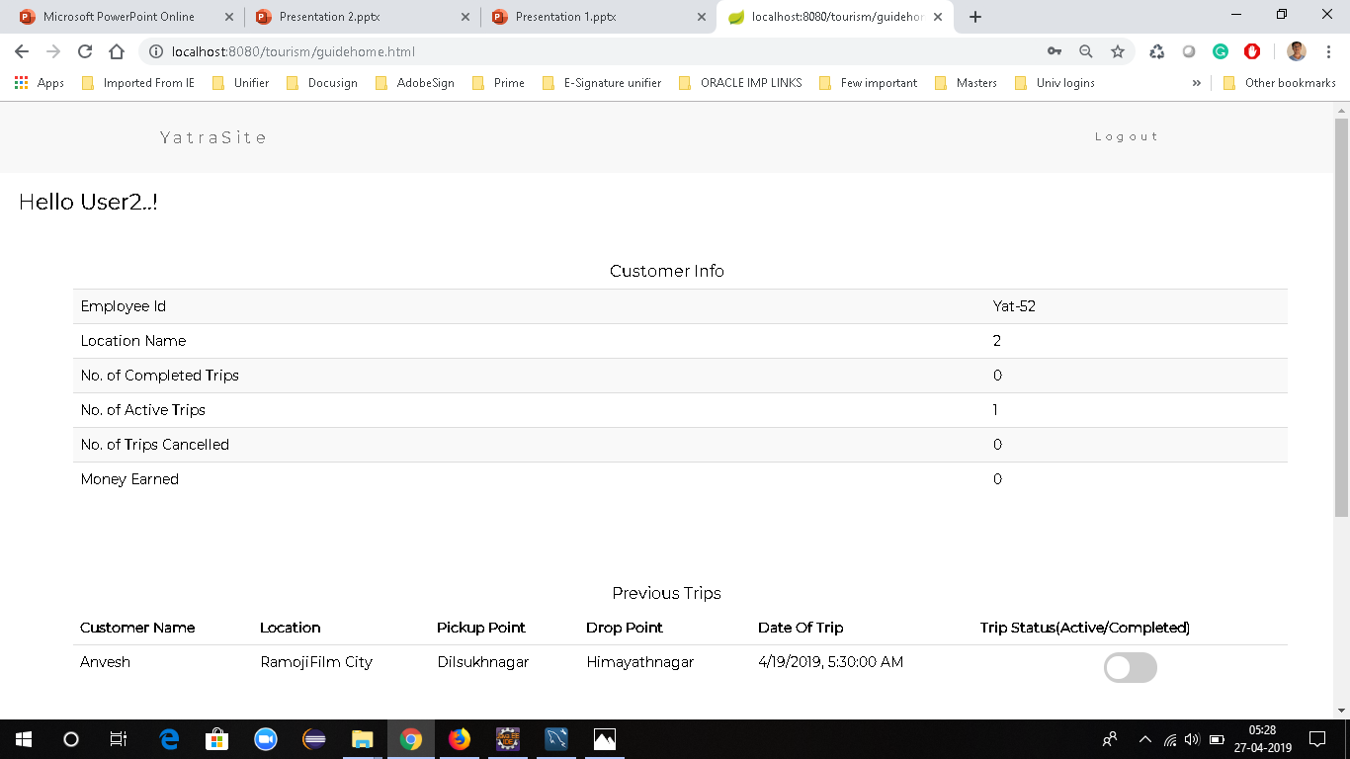
Trip Allotment to guide:

Slide 15
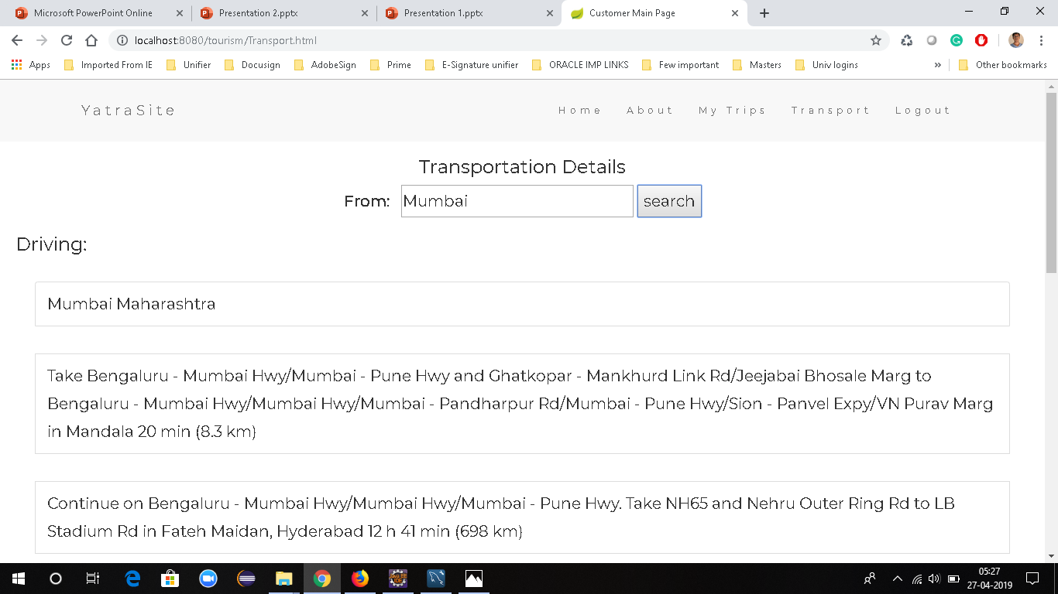
Transportation Details:

Slide 16
Future Work:
Extending the work with few more features
Adding few more validations

Slide 17


